Slide 1
Multivariate Regression
Setting and Notation

Slide 2
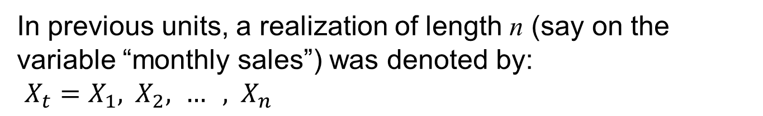
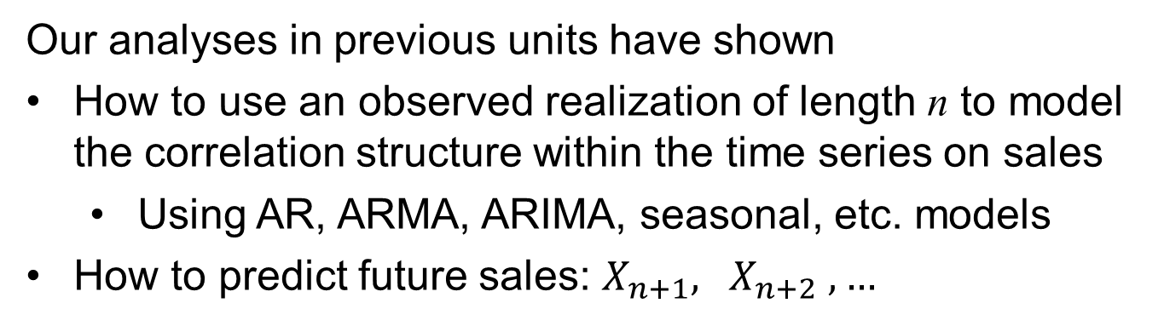
Univariate modeling
In previous units, a realization of length n (say on the variable “monthly sales”) was denoted by: ${X_{t}=X}_{1}, { X}_{2}, … , { X}_{n}$
Our analyses in previous units have shown
How to use an observed realization of length n to model the correlation structure within the time series on sales
Using AR, ARMA, ARIMA, seasonal, etc. models
How to predict future sales: $X_{n+1}, { X}_{n+2}, …$
This is called a univariate (one-variable) approach
Multivariate modeling
In this unit we will consider multivariate approaches that use more than one time-series variable to better understand data, make decisions (forecasts, etc.)

Slide 3
Multiple Regression with Correlated Errors
The first technique we will discuss is a direct extension of the multiple regression model. In the time series setting, each of the variables (independent and dependent) depend on time and occur as realizations of the same length.
In the case in which each of the dependent and independent variables depend on time, it is common for the errors to be auto-correlated
This was true when testing for trend in the temperature data
In which case the only independent variables was time
We used the Cochrane-Orcutt procedure
Another option is an MLE approach that we will illustrate in the next example

Slide 4
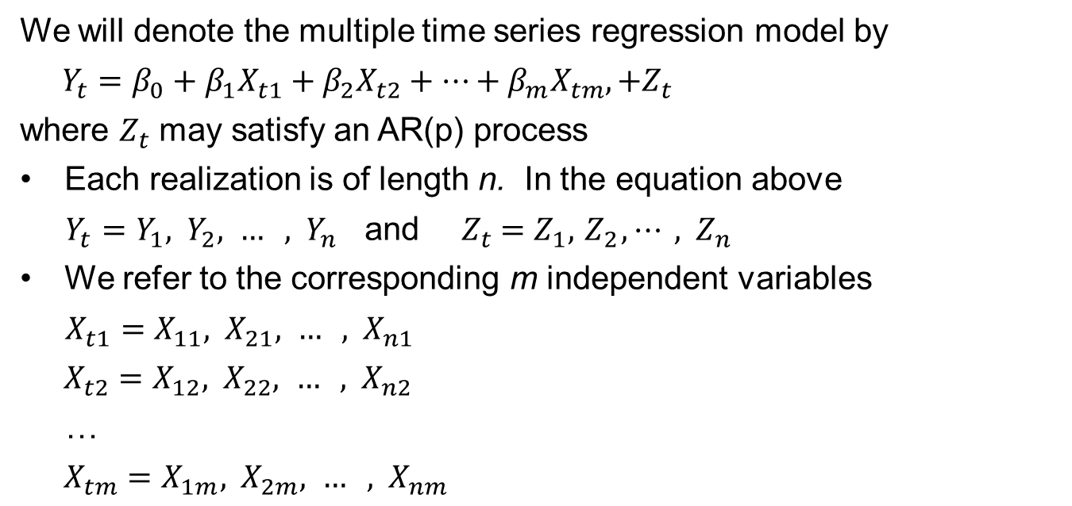
Multiple Regression with Correlated Errors
Notation
We will denote the multiple time series regression model by
${Y_{t}=β_{0}+β_{1}X}_{t1}+{β_{2}X}_{t2}+⋯+{β_{m}X}_{tm},+Z_{t}$
where $Z_{t}$ may satisfy an AR(p) process
Each realization is of length n. In the equation above
$Y_{t}=Y_{1}, { Y}_{2}, … , { Y}_{n}$ and ${{ Z}_{t} =Z}_{1}, { Z}_{2}, ⋯ , { Z}_{n}$
We refer to the corresponding m independent variables
${X_{t1}=X}_{11}, { X}_{21}, … , { X}_{n1}$
${X_{t2}=X}_{12}, { X}_{22}, … , { X}_{n2}$
…
${X_{tm}=X}_{1m}, { X}_{2m}, … , { X}_{nm}$
Note that for the independent variables:
The first subscript is time (1, 2, … , n)
The second subscript indicates which variable it is

Slide 6
Multivariate Regression
R-Based Analysis

Slide 7
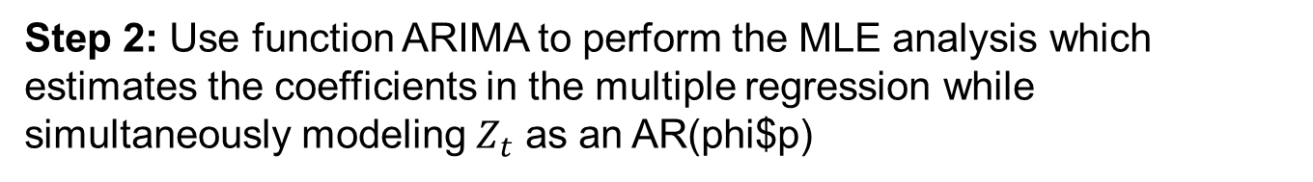
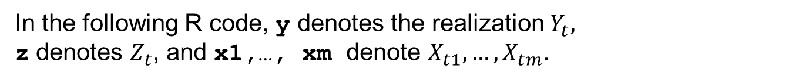
Multiple Regression with Correlated Errors
R-based analysis strategy
In the following R code, y denotes the realization $Y_{t},$ z denotes $Z_{t}$, and x1,…, xm denote $X_{t1}, …, X_{tm}$.
Step 1: Perform a regression analysis and model the residuals. The following is example code (with m=3):
ksfit=lm(y~x1+x2+x3)
phi=aic.wge(ksfit$residuals,p=0:8)
Step 2: Use function ARIMA to perform the MLE analysis which estimates the coefficients in the multiple regression while simultaneously modeling $Z_{t}$ as an AR(phi$p)
fit=arima(sales,order=c(phi$p,0,0)xreg=cbind(x1,x2,x3))
fit$coef contains the AR coefficients, the constant, and the coefficients on x1, x2, and x3

Slide 8
Multiple Regression with Correlated Errors
R-based analysis strategy
The command
fit
produces the following example “dummy” output (assuming phi$p=2)
Coefficients:
ar1 ar2 intercept x1 x2 x3
1.6 -0.8 10.5 2.3 3.1 0.3
s.e. 0.6 0.3 2.2 0.9 1.2 0.2
sigma2 estimated as 1.4: log likelihood=-16,aic=20.1
Recall that we don’t usually look at the SE’s for AR and MA coefficients (the factor table gives more information).
Function arima doesn’t give p-values, but in general if the absolute value of the coefficient is over two times the SE, this is evidence at the .05 level that the variable is useful.
The final model residuals are given in fit$resid, and they should be white
Check with residual plots and/or Ljung-Box Test.
Compare competing models with AIC/AIC/BIC etc.
Use the model to forecast and/or answer any additional QOIs.

Slide 10
Multivariate Regression: Example
Sales Data

Slide 11
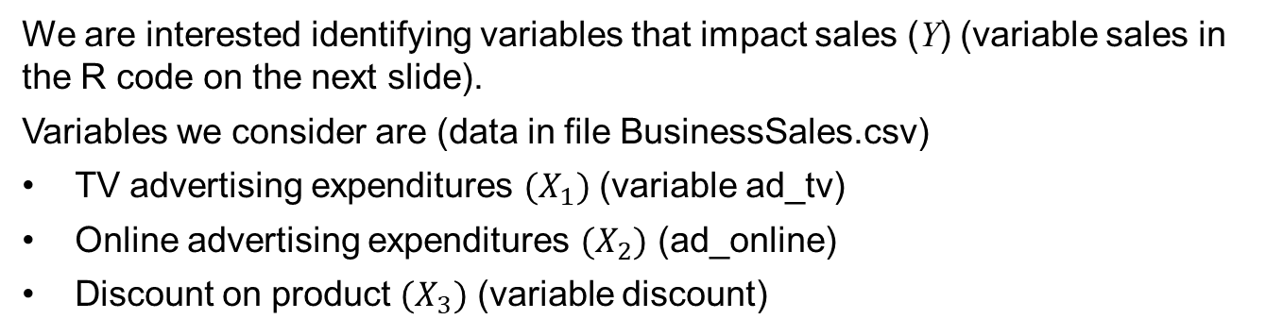
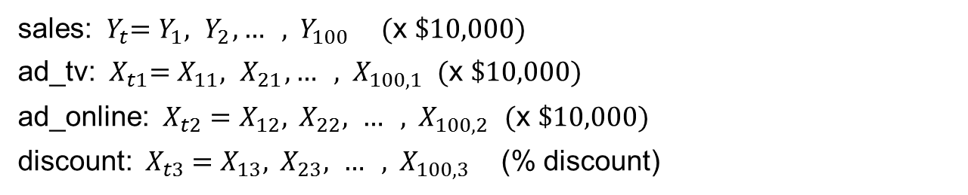
Multiple Regression with Correlated Errors
Example
We are interested identifying variables that impact sales (Y) (variable sales in the R code on the next slide).
Variables we consider are (data in file BusinessSales.csv)
TV advertising expenditures $(X_{1})$ (variable ad_tv)
Online advertising expenditures $(X_{2})$ (ad_online)
Discount on product $(X_{3})$ (variable discount)
We have data for the past 100 weeks. That is, for each variable, we have a time series realization of length n =100 (weeks):
sales: ${{ Y}_{t}=Y}_{1}, { Y}_{2},… , { Y}_{100}$ (x $10,000)
ad_tv:${{ X}_{t1}=X}_{11}, { X}_{21}, … , { X}_{100,1}$ (x $10,000)
ad_online: ${X_{t2}=X}_{12}, { X}_{22}, … , { X}_{100,2}$ (x $10,000)
discount: ${{ X}_{t3} =X}_{13}, { X}_{23}, … , { X}_{100,3}$ (% discount)

Slide 12
Hypothetical Sales Data

Slide 13
Multiple Regression with Correlated Errors
R code
#Assuming a data.frame exists with corresponding names below.
ksfit=lm(sales~ad_tv+ad_online+discount, data = BSales)
aic.wge(ksfit$residuals,p=0:8, q=0) # AIC picks p=7
fit=arima(Bsales$sales,order=c(7,0,0),xreg=BSales[,3:5])
fit
Output time series multiple regression analysis
Coefficients:
ar1 ar2 ar3 ar4 ar5 ar6 ar7
1.4734 -0.8921 0.0749 0.0919 0.0438 0.1865 -0.1287
s.e.0.1107 0.1963 0.2167 0.2057 0.2049 0.1852 0.1080
intercept ad_tv ad_online discount
54.5513 0.0703 -0.0934 -0.1514
2.2040 0.3434 0.2075 0.1315
sigma^2 estimated as 1.411: log likelihood=-161.1, aic=346.21
Multiple regression equation
$$sales=54.55+.07\left({ad}_{tv}\right)−.09\left({online}_{ad}\right)−.15(discount)$$

Slide 14
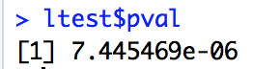
Comments about Regression Equation
Results:
The errors in the standard multiple regression satisfy an AR(7) and are correlated
None of the variables ad_tv, ad_online, or discount are significantly different from zero
The final model residuals are not white (fit$resid)
ltest = ljung.wge(fit$resid)
ltest$pval
acf(fit$resid)
There is strong evidence that the residuals are serially correlated.
Summary:
These results are not very enlightening (or encouraging)
Let’s try adding a trend term to the model

Slide 15
Multiple Regression with Correlated Errors
Add a trend term (t=week) to the model
t=1:100
ksfit=lm(sales~t+ad_tv+ad_online+discount, data = BSales)
aic.wge(ksfit$residuals,p=0:8,q=0:0) # AIC picks p=6
fit=arima(BSales$sales,order=c(6,0,0),xreg=cbind(t,BSales[,3:5]))
fit
Output time series multiple regression analysis
Coefficients:
ar1 ar2 ar3 ar4 ar5 ar6
1.4090 -0.8778 0.0180 0.0562 0.1676 -0.0364
s.e. 0.1131 0.1978 0.2182 0.2057 0.1785 0.1050
intercept t ad_tv ad_online discount
51.9224 0.0465 0.1123 -0.0508 -0.1701
2.2242 0.0148 0.3549 0.1939 0.1052
sigma^2 estimated as 1.363: log likelihood = -159.14, aic = 342.29
time (week) is significant, other variables are not
Multiple regression equation
$$sales=51.92+.05\left(week\right)+.11\left({ad}_{tv}\right)−.05\left({online}_{ad}\right)−.17(discount)$$

Slide 16
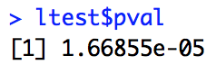
Comments about Regression Equation with Trend Included
Results:
Again the errors in the standard multiple regression satisfy an AR(6) and are correlated
Time was significant (with positive slope) so it seems that sales are increasing with time
None of the variables ad_tv, ad_online, or discount are significantly different from zero
The final model residuals are not white
ltest = ljung.wge(fit$resid)
ltest$pval
There is strong evidence that the residuals are serially correlated.
Summary:
Let’s keep working on this
acf(fit$resid)

Slide 18
Multivariate Regression
Lagged Variables

Slide 19
How About Using Lagged Variables?
Advertising for the week didn’t seem to predict sales for that week
It could be that advertising has a “lag” effect
That is, advertising for the current week may have more effect on sales next week than this week
We next considered a multiple regression in which the “advertising variables at time t” are actually costs for the previous week
These will be denoted ad_tv1 and ad_online1
The new variables will be
ad_tv1[t]=ad_tv[t-1]
ad_online1[t]=ad_online[t-1]

Slide 20
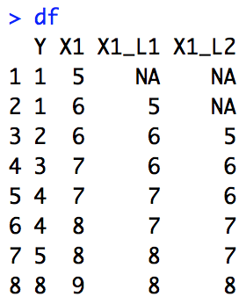
Creating Lagged Variables in R
Example:
#Explicitly
df = data.frame(Y = c(1,1,2,3,4,4,5,8),X1 = c(5,6,6,7,7,8,8,9))
X1_L1 = numeric(length(df$X1))
X1_L1 = c(NA,df$X1[1:length(df$X1)-1]) #X1 lagged once
X1_L2 = c(NA,NA,df$X1[(1-(length(df$X1)-2))]) #X1 lagged twice
df$X1_L1 = X1_L1
df$X1_L2 = X1_L2
df
#Example:
#With dplyr lag function
df = data.frame(Y = c(1,1,2,3,4,4,5,8),X1 = c(5,6,6,7,7,8,8,9))
df$X1_L1 = dplyr::lag(df$X1,1)
df$X1_L2 = dplyr::lag(df$X1,2)
df

Slide 22
Multivariate Regression: Example Part 2
Using Lagged Variables

Slide 23
Multiple Regression with Correlated Errors
ad_tv1 = dplyr::lag(BSales$ad_tv,1)
ad_online1 = dplyr::lag(BSales$ad_online,1)
discount = BSales$discount
BSales$ad_tv1= ad_tv1
BSales$ad_online1 = ad_online1
ksfit=lm(sales~ad_tv1+ad_online1+discount, data = BSales)
aic.wge(ksfit$residuals,p=0:8,q=0:0) # AIC picks p=7
fit=arima(BSales$sales,order=c(7,0,0),xreg=cbind(ad_tv1, ad_online1, discount))
fit
With Lagged “ad” variables
${{Sales}_{t}={_{0}+}_{1}ad_tv}_{t−1}+{_{2}ad_online}_{t−1}+{_{3}discount}_{t,}+Z_{t}$ ${ Z}_{t}$ is AR(7)
Coefficients:
ar1 ar2 ar3 ar4 ar5 ar6 ar7
-0.5197 0.1348 -0.0787 -0.1155 -0.1954 -0.0004 0.0485
s.e. 0.1839 0.1689 0.1233 0.1256 0.1309 0.1884 0.1574
intercept ad_tv1 ad_online1 discount
4.8382 3.4341 8.1152 -0.0573
s.e. 2.8270 0.6166 1.2447 0.0281
sigma^2 estimated as 1.642: log likelihood = -165.43, aic = 354.86
both “ad” variables are highly significant

Slide 24
Multiple Regression with Correlated Errors
t=1:100
ad_tv1 = dplyr::lag(BSales$ad_tv,1)
ad_online1 = dplyr::lag(BSales$ad_online,1)
BSales$ad_tv1= ad_tv1
BSales$ad_online1 = ad_online1
ksfit=lm(sales~t + ad_tv1+ad_online1+discount, data = BSales)
aic.wge(ksfit$residuals,p=0:8,q=0:0) # AIC picks p=7
fit=arima(Bsales$sales,order=c(7,0,0),xreg=cbind(t, ad_tv1, ad_online1, discount))
fit
Lagged “ad” variables and trend
${{Sales}_{t}={_{0}+_{1}t+}_{2}ad_tv}_{t−1}+{_{3}ad_online}_{t−1}+{_{4}discount}_{t,}+Z_{t}$ ${ Z}_{t}$ is AR(7)
Coefficients:
ar1 ar2 ar3 ar4 ar5 ar6 ar7
-0.5062 0.1265 -0.1053 -0.1388 -0.1985 0.0109 0.0493
s.e. 0.1883 0.1537 0.1138 0.1160 0.1206 0.1805 0.1535
intercept t ad_tv1 ad_online1 discount
6.2215 0.0065 3.3180 7.8248 -0.0453
s.e. 2.7820 0.0038 0.6288 1.3020 0.0276
sigma^2 estimated as 1.577: log likelihood = -163.43, aic = 352.87
both “ad” variables are highly significant

Slide 25
Multiple Regression with Correlated Errors
Lagged “ad” variables
Coefficients:
ar1 ar2 ar3 ar4 ar5 ar6 ar7
-0.5197 0.1348 -0.0787 -0.1155 -0.1954 -0.0004 0.0485
s.e. 0.1839 0.1689 0.1233 0.1256 0.1309 0.1884 0.1574
intercept ad_tv1 ad_online1 discount
4.8382 3.4341 8.1152 -0.0573
s.e. 2.8270 0.6166 1.2447 0.0281
sigma^2 estimated as 1.642: log likelihood = -165.43, aic = 354.86
both “ad” variables are highly significant
Lagged “ad” variables and trend
Coefficients:
ar1 ar2 ar3 ar4 ar5 ar6 ar7
-0.5062 0.1265 -0.1053 -0.1388 -0.1985 0.0109 0.0493
s.e. 0.1883 0.1537 0.1138 0.1160 0.1206 0.1805 0.1535
intercept t ad_tv1 ad_online1 discount
6.2215 0.0065 3.3180 7.8248 -0.0453
s.e. 2.7820 0.0038 0.6288 1.3020 0.0276
sigma^2 estimated as 1.577: log likelihood = -163.43, aic = 352.87
AIC favors model with trend

Slide 26
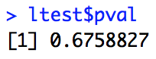
Comments about Results Using Lagged Variables
Results:
Again, the errors in the standard multiple regression are correlated.
Discount was not significant with or without trend in the model.
Lagged variables ad_tv1 and ad_online1 were highly significant.
In the presence of the lagged variables, time (trend) was not significant (although favored by AIC).
The final model residuals (with trend) are white:
ltest = ljung.wge(fit$resid)
ltest$pval
There are not enough evidence to suggest that the residuals are serially correlated.
Summary:
Advertising effects seem to be delayed

Slide 27
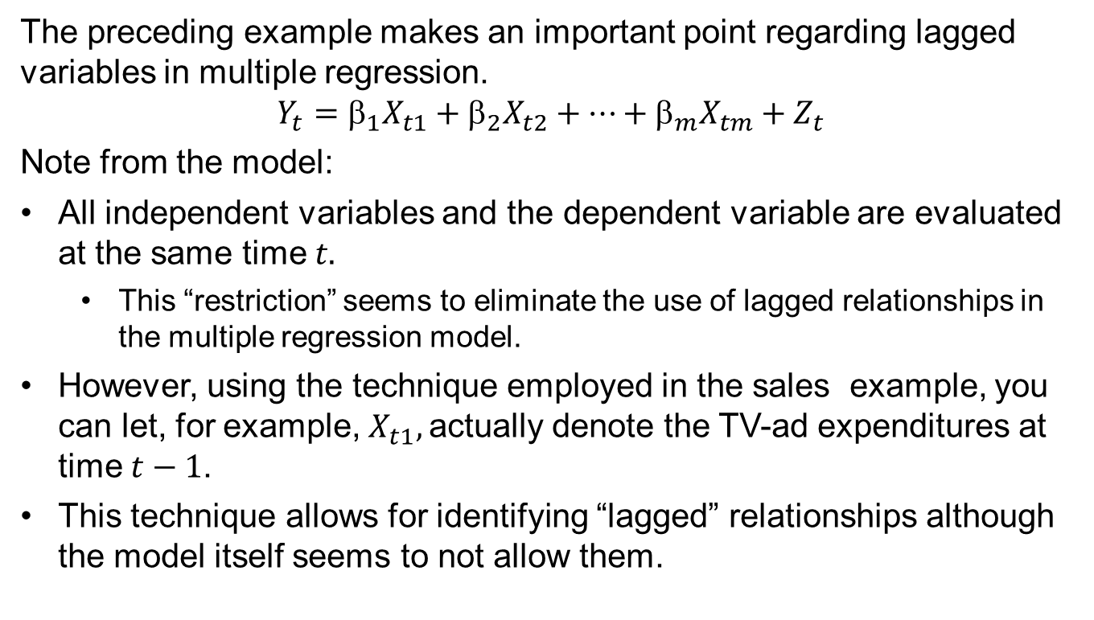
Lagged Variables in Multiple Regression with Correlated Errors
The preceding example makes an important point regarding lagged variables in multiple regression.
$${Y_{t}=_{1}X}_{t1}+{_{2}X}_{t2}+⋯+{_{m}X}_{tm}+Z_{t}$$
Note from the model:
All independent variables and the dependent variable are evaluated at the same time $t.$
This “restriction” seems to eliminate the use of lagged relationships in the multiple regression model.
However, using the technique employed in the sales example, you can let, for example, $X_{t1},$actually denote the TV-ad expenditures at time $t−1$.
This technique allows for identifying “lagged” relationships although the model itself seems to not allow them.

Slide 28
A Note about Lagged Variables in Multiple Time Series Analysis
When predicting gross domestic product (GDP) at time t, economists use leading economic indicators that have been observed at time t− k such as
Unemployment rate
Income and wages
Corporate profits
Etc.
Point to remember:
Don’t forget to consider lagged information.

Slide 30
Multivariate Regression
Cross-Correlation

Slide 31
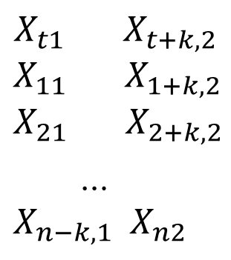
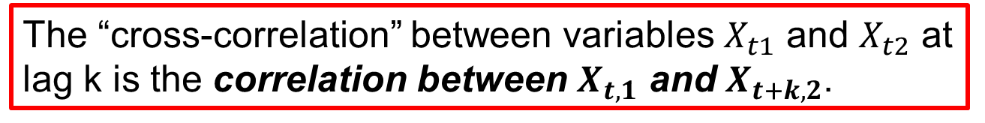
Cross-Correlation between 2 Time Series
A useful tool for detecting the existence of “lagged relationships” in multivariate time series analysis is the cross-correlation function.
The “cross-correlation” between variables $X_{t1}$ and $X_{t2}$ at lag k is the correlation between $X_{t,1}$ and $X_{t+k,2}$.
We find the cross-correlation at lag k using the following ordered pairs
$$X_{t1} { X}_{t+k,2}$$
$$X_{11} { X}_{1+k,2}$$
$$X_{21}{ X}_{2+k,2}$$
…
$$X_{n−k,1}{ X}_{n2}$$

Slide 32
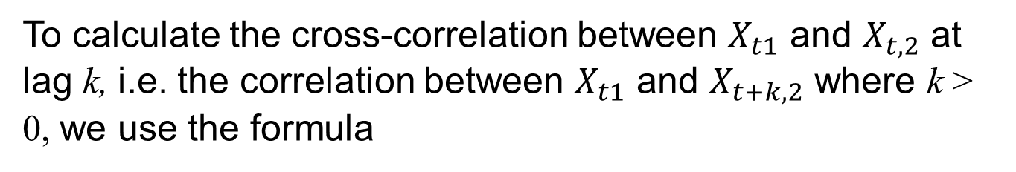
Cross-Correlation between 2 Time Series
To calculate the cross-correlation between $X_{t1}$ and $X_{t,2}$ at lag k, i.e. the correlation between $X_{t1}$ and $X_{t+k,2}$ where k > 0, we use the formula

Slide 33
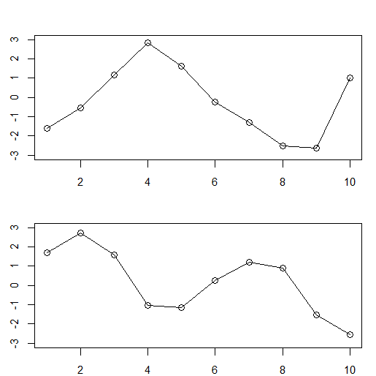
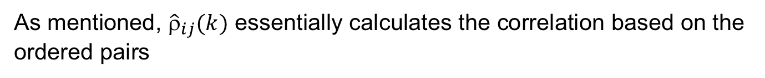
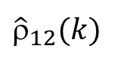
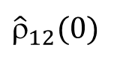
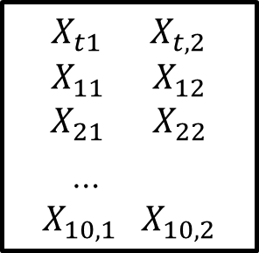
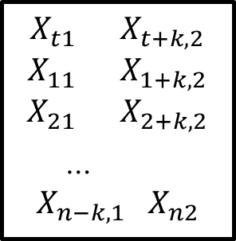
Cross-Correlation between 2 Time Series
As mentioned, ${\hat{ρ}}_{ij}(k)$ essentially calculates the correlation based on the ordered pairs
${\hat{ρ}}_{12}(k)$
x1
$$X_{t1} { X}_{t+k,2}$$
$$X_{11} { X}_{1+k,2}$$
$$X_{21} { X}_{2+k,2}$$
…
$$X_{n−k,1} X_{n2}$$
${\hat{ρ}}_{12}(0)$
x2
$$X_{t1} { X}_{t,2}$$
$$X_{11} { X}_{12}$$
$$X_{21} { X}_{22}$$
…
$$X_{10,1} X_{10,2}$$

Slide 34
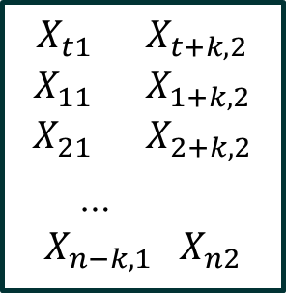
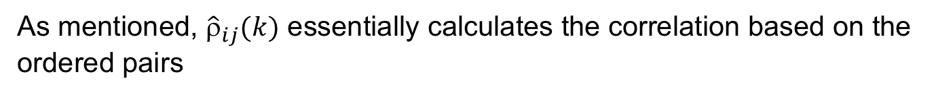
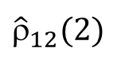
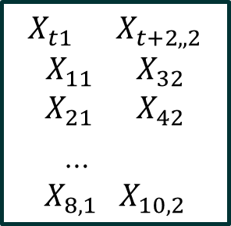
Cross-Correlation between 2 Time Series
As mentioned, ${\hat{ρ}}_{ij}(k)$ essentially calculates the correlation based on the ordered pairs
${\hat{ρ}}_{12}(k)$
x1
$$X_{t1} { X}_{t+k,2}$$
$$X_{11} { X}_{1+k,2}$$
$$X_{21} { X}_{2+k,2}$$
…
$$X_{n−k,1} X_{n2}$$
${\hat{ρ}}_{12}(2)$
x2
$$X_{t1} { X}_{t+2,,2}$$
$$X_{11} { X}_{32}$$
$$X_{21} { X}_{42}$$
…
$$X_{8,1} X_{10,2}$$

Slide 35
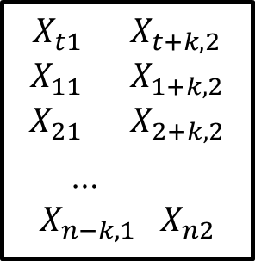
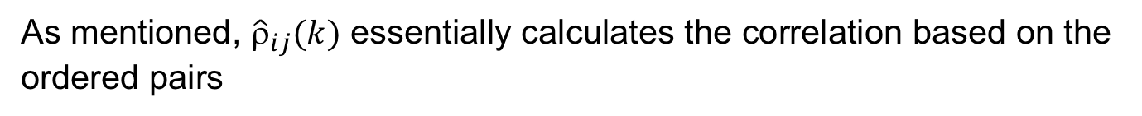
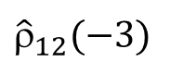
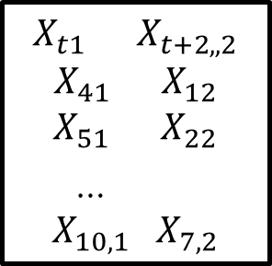
Cross-Correlation between 2 Time Series
As mentioned, ${\hat{ρ}}_{ij}(k)$ essentially calculates the correlation based on the ordered pairs
${\hat{ρ}}_{12}(k)$
x1
$$X_{t1} { X}_{t+k,2}$$
$$X_{11} { X}_{1+k,2}$$
$$X_{21} { X}_{2+k,2}$$
…
$$X_{n−k,1} X_{n2}$$
${\hat{ρ}}_{12}(−3)$
x2
$$X_{t1} { X}_{t+2,,2}$$
$$X_{41} { X}_{12}$$
$$X_{51} { X}_{22}$$
…
$$X_{10,1} X_{7,2}$$

Slide 36
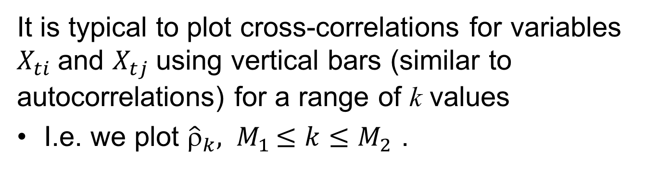
Graphical Presentation of Cross-Correlations
It is typical to plot cross-correlations for variables $X_{ti}$and $X_{tj}$using vertical bars (similar to autocorrelations) for a range of k values
I.e. we plot ${\hat{ρ}}_{k}{, M}_{1}≤k≤M_{2}$ .
On the next slide we plot cross-correlations between sales, and the three explanatory variables
ad_tv
ad_online
discount

Slide 37
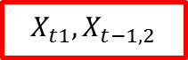
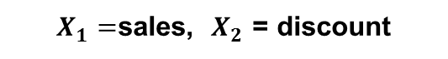
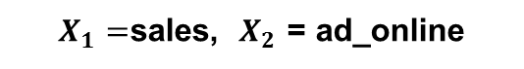
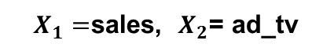
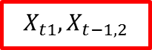
Cross-correlations
$X_{1}=$sales, $X_{2}$= ad_tv
$$X_{t1}, X_{t−1,2}$$
$X_{1}=$sales, $X_{2}$ = ad_online
$$X_{t1}, X_{t−1,2}$$
$X_{1}=$sales, $X_{2}$ = discount
No strong cross-correlations

Slide 38
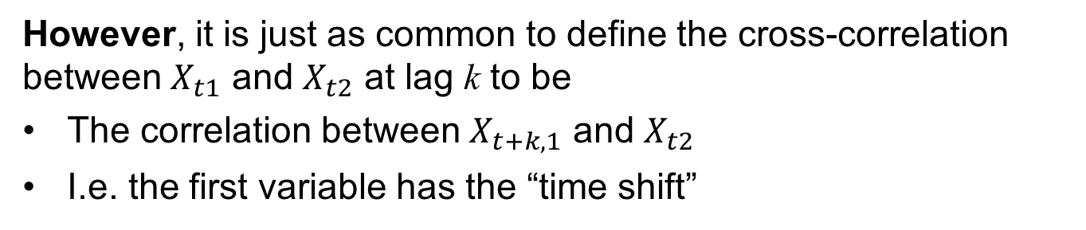
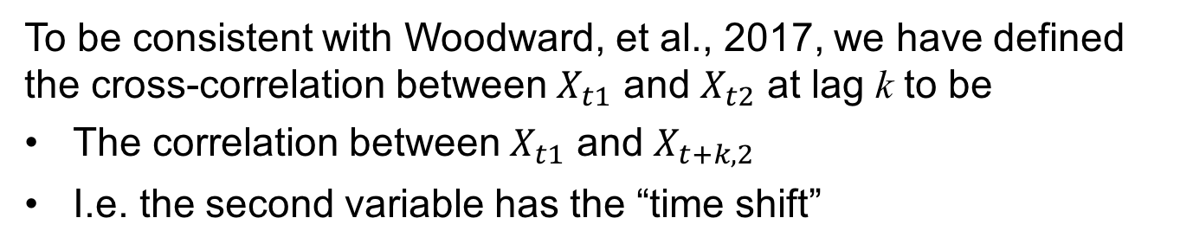
Be careful:
To be consistent with Woodward, et al., 2017, we have defined the cross-correlation between $X_{t1}$ and $X_{t2}$ at lag k to be
The correlation between $X_{t1}$ and $X_{t+k,2}$
I.e. the second variable has the “time shift”
However, it is just as common to define the cross-correlation between $X_{t1}$ and $X_{t2}$ at lag k to be
The correlation between $X_{t+k,1}$ and $X_{t2}$
I.e. the first variable has the “time shift”
Please note:
Base R function ccf uses the second definition!
In order to find the cross-correlation between x1 and x2 using our definition use the statement ccf(x2,x1)

Slide 40
VAR Models | Definition and Example

Slide 41
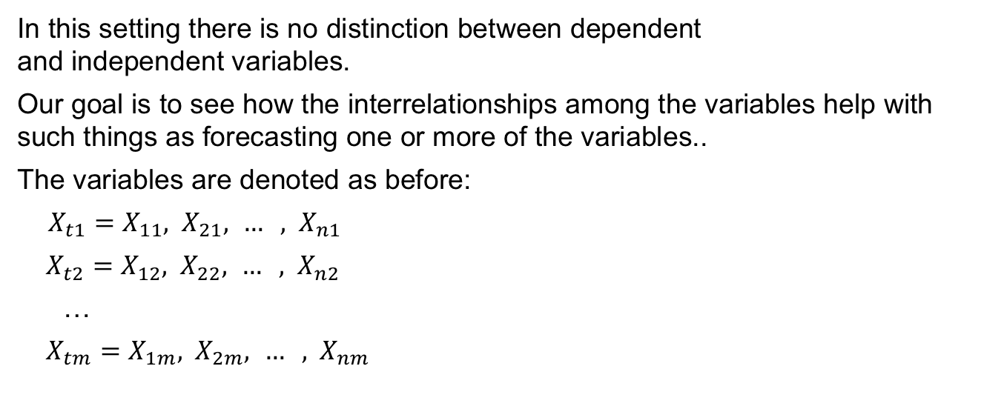
Vector AR (VAR) Models
Simultaneously modeling several time series
In the multiple regressions with correlated errors we did not take into account the possible correlation structure within and among the independent variables.
In this setting there is no distinction between dependent and independent variables.
Our goal is to see how the interrelationships among the variables help with such things as forecasting one or more of the variables..
The variables are denoted as before:
${X_{t1}=X}_{11}, { X}_{21}, … , { X}_{n1}$
${X_{t2}=X}_{12}, { X}_{22}, … , { X}_{n2}$
…
${X_{tm}=X}_{1m}, { X}_{2m}, … , { X}_{nm}$
First subscript is time
Second subscript is variable number

Slide 42
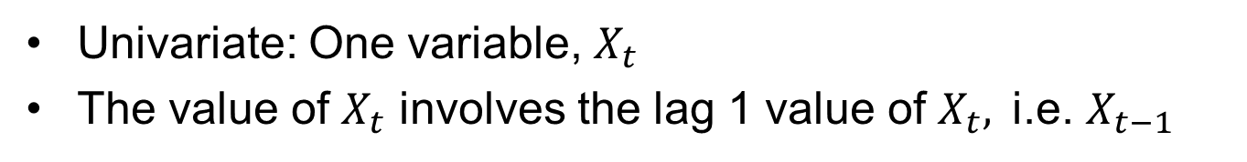
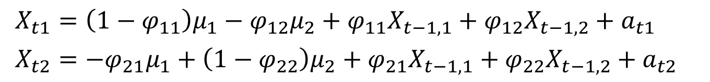
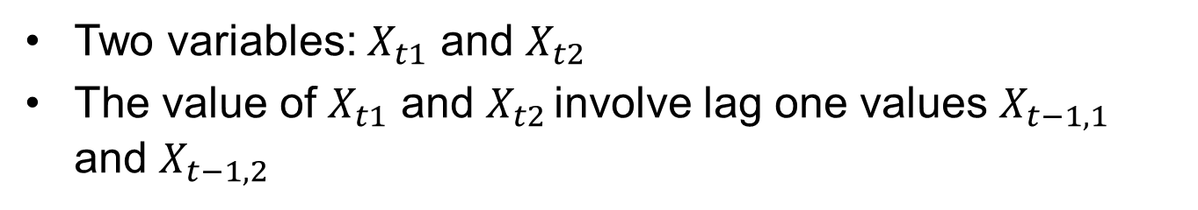
Example: Bivariate VAR(1) Process
Recall AR(1): $X_{t}={\left(1−φ_{1}\right)μ+φ}_{1}X_{t−1}+a_{t}$
Univariate: One variable, $X_{t}$
The value of $X_{t}$ involves the lag 1 value of $X_{t},$i.e. $X_{t−1}$
Bivariate VAR(1):
$X_{t1}={\left(1−φ_{11}\right)μ_{1}−φ_{12}μ_{2}+φ}_{11}X_{t−1,1}+φ_{12}X_{t−1,2}+a_{t1}$
$X_{t2}={−φ_{21}μ_{1}+\left(1−φ_{22}\right)μ_{2}+φ}_{21}X_{t−1,1}+φ_{22}X_{t−1,2}+a_{t2}$
Two variables: $X_{t1}$ and $X_{t2}$
The value of $X_{t1}$ and $X_{t2 }$involve lag one values $X_{t−1,1}$ and $X_{t−1,2}$

Slide 43
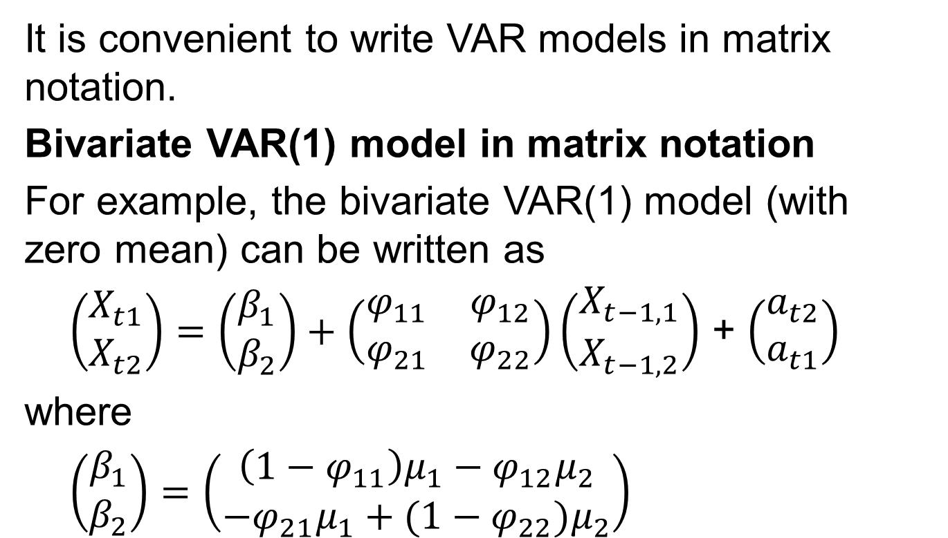
Matrix Notation
It is convenient to write VAR models in matrix notation.
Bivariate VAR(1) model in matrix notation
For example, the bivariate VAR(1) model (with zero mean) can be written as
$\left(\begin{matrix}X_{t1} \\ X_{t2}\end{matrix}\right)=\left(\begin{matrix}β_{1} \\ β_{2}\end{matrix}\right)+\left(\begin{matrix}φ_{11} & φ_{12} \\ φ_{21} & φ_{22}\end{matrix}\right)\left(\begin{matrix}X_{t−1,1} \\ X_{t−1,2}\end{matrix}\right)$ + $\left(\begin{matrix}a_{t2} \\ a_{t1}\end{matrix}\right)$
where
$\left(\begin{matrix}β_{1} \\ β_{2}\end{matrix}\right)=\left(\begin{matrix}\left(1−φ_{11}\right)μ_{1}−φ_{12}μ_{2} \\ −φ_{21}μ_{1}+(1−φ_{22})μ_{2}\end{matrix}\right)$

Slide 44
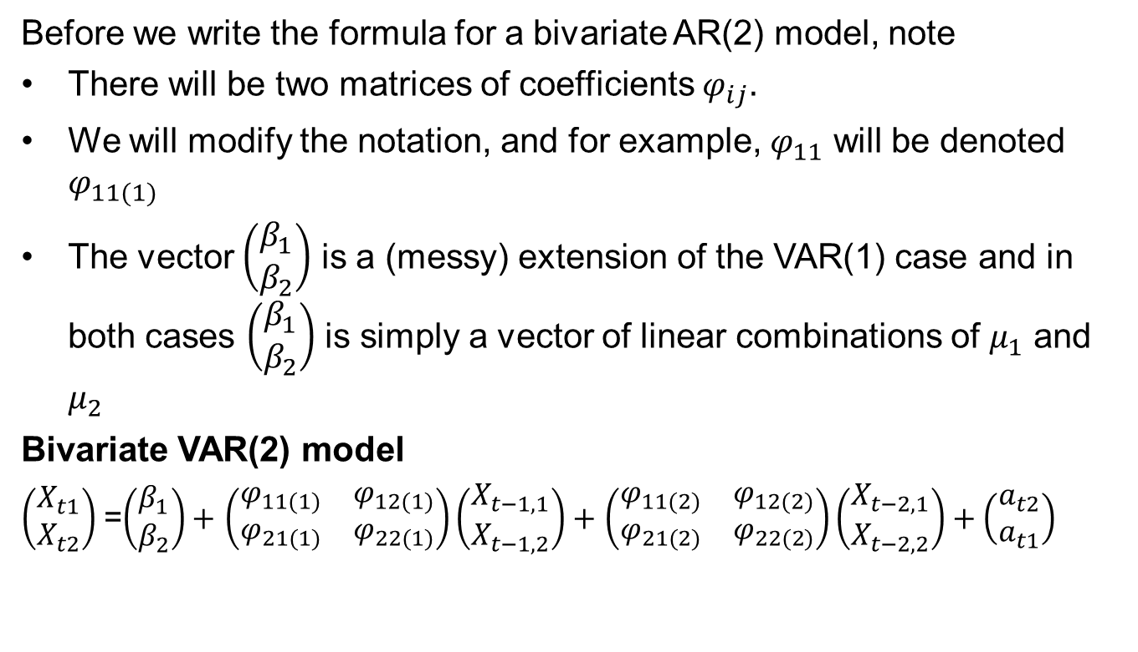
Matrix Notation
Before we write the formula for a bivariate AR(2) model, note
There will be two matrices of coefficients $φ_{ij}.$
We will modify the notation, and for example, $φ_{11}$ will be denoted $φ_{11(1)}$
The vector $\left(\begin{matrix}β_{1} \\ β_{2}\end{matrix}\right)$ is a (messy) extension of the VAR(1) case and in both cases $\left(\begin{matrix}β_{1} \\ β_{2}\end{matrix}\right)$ is simply a vector of linear combinations of $μ_{1}$ and $μ_{2}$
Bivariate VAR(2) model
$\left(\begin{matrix}X_{t1} \\ X_{t2}\end{matrix}\right)$ =$\left(\begin{matrix}β_{1} \\ β_{2}\end{matrix}\right)+$ $\left(\begin{matrix}φ_{11(1)} & φ_{12(1)} \\ φ_{21(1)} & φ_{22(1)}\end{matrix}\right)\left(\begin{matrix}X_{t−1,1} \\ X_{t−1,2}\end{matrix}\right)+$ $\left(\begin{matrix}φ_{11(2)} & φ_{12(2)} \\ φ_{21(2)} & φ_{22(2)}\end{matrix}\right)\left(\begin{matrix}X_{t−2,1} \\ X_{t−2,2}\end{matrix}\right)+\left(\begin{matrix}a_{t2} \\ a_{t1}\end{matrix}\right)$

Slide 45
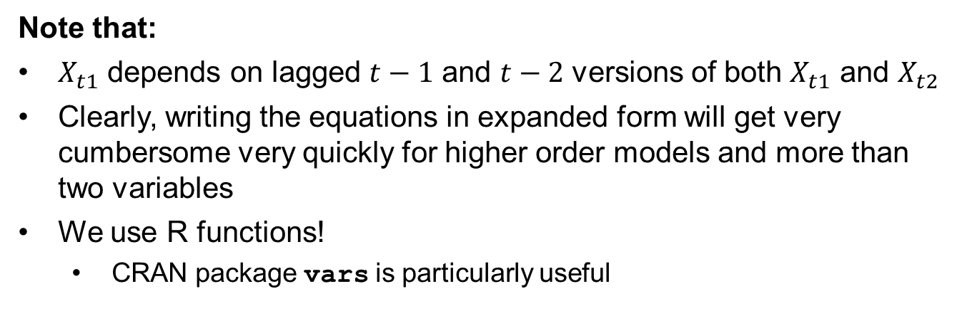
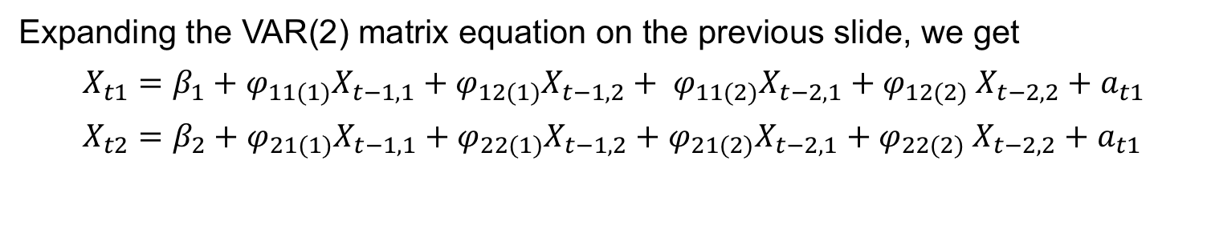
Bivariate VAR(2)
Expanding the VAR(2) matrix equation on the previous slide, we get
$X_{t1}={β_{1}+φ}_{11(1)}X_{t−1,1}+φ_{12(1)}X_{t−1,2}+{{ φ}_{11(2)}X}_{t−2,1}{+ φ}_{12(2)}X_{t−2,2}+a_{t1}$
$X_{t2}={β_{2}+φ}_{21(1)}X_{t−1,1}+φ_{22(1)}X_{t−1,2}+{φ_{21(2)}X}_{t−2,1}{+ φ}_{22(2)}X_{t−2,2}+a_{t1}$
Note that:
$X_{t1}$ depends on lagged $t−1$ and $t−2$ versions of both $X_{t1}$ and $X_{t2}$
Clearly, writing the equations in expanded form will get very cumbersome very quickly for higher order models and more than two variables
We use R functions!
CRAN package vars is particularly useful

Slide 47
Forecasting with VAR Models

Slide 48
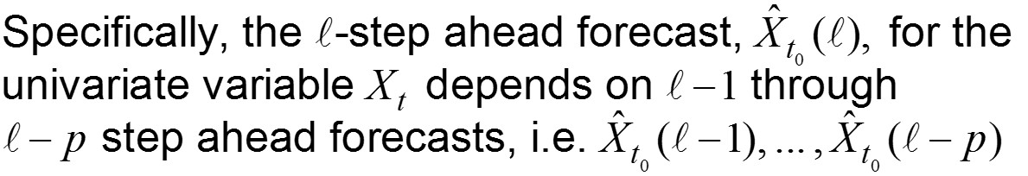
Forecasting with VAR(p) Models
Forecasting with VAR(p) models is simply an extension of forecasting with AR(p) models
Quick review: forecasting with AR(p) models
Forecasts for an AR(p) model are based on the underlying AR(p) equation and are given by
(some of which may be actual observed values)

Slide 49
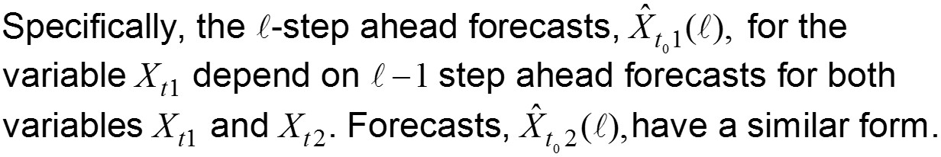
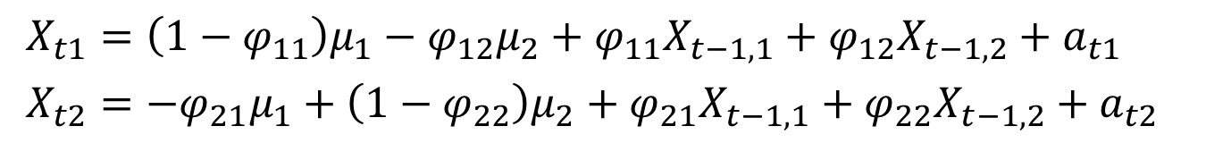
Forecasting with VAR(p) Models
For simplicity we will show forecasts for a bivariate VAR(1) model
$X_{t1}={\left(1−φ_{11}\right)μ_{1}−φ_{12}μ_{2}+φ}_{11}X_{t−1,1}+φ_{12}X_{t−1,2}+a_{t1}$
$X_{t2}={−φ_{21}μ_{1}+\left(1−φ_{22}\right)μ_{2}+φ}_{21}X_{t−1,1}+φ_{22}X_{t−1,2}+a_{t2}$
The forecasts are given by

Slide 51
VAR Models | Example

Slide 52
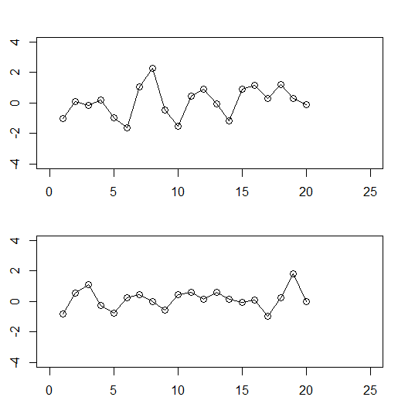
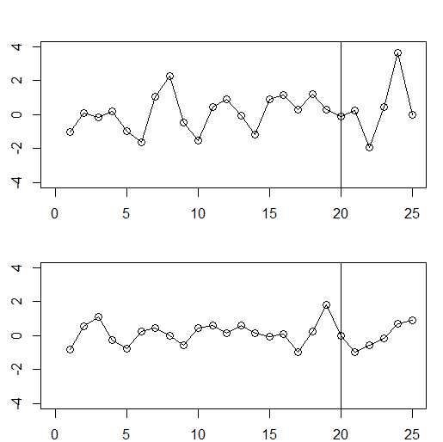
Bivariate VAR Time Series Example
x1
We know data out to t=25
x2
We will perform analysis based on data only up to t=20

Slide 53
R Code using tswge and vars to Analyze Bivariate Data (x1,x2)
x1.25=c( -1.03, 0.11, -0.18, 0.20, -0.99, -1.63, 1.07, 2.26, -0.49, -1.54, 0.45, 0.92,
-0.05, -1.18, 0.90, 1.17, 0.31, 1.19, 0.27, -0.09, 0.23, -1.91, 0.46, 3.61, -0.03)
x2.25=c( -0.82, 0.54, 1.13, -0.24, -0.77, 0.22, 0.46, -0.03, -0.59, 0.45, 0.59, 0.15,
0.60, 0.13, -0.04, 0.12, -0.96, 0.23, 1.81, -0.01, -0.95, -0.55, -0.15, 0.71, 0.90)
x1=x1.25[1:20]
x2=x2.25[1:20]
p1=aic.wge(x1,p=0:8,q=0:0)
# aic picks p=2
x1.est=est.ar.wge(x1,p=p1$p)
fore.arma.wge(x1,phi=x1.est$phi,n.ahead=5,lastn=FALSE,limits=FALSE)
p2=aic.wge(x2,p=0:8,q=0:0)
# aic picks p=2
x2.est=est.ar.wge(x1,p=p2$p)
fore.arma.wge(x2,phi=x2.est$phi,n.ahead=5,lastn=FALSE,limits=FALSE)
#
# VAR and VARselect are from CRAN package vars
X=cbind(x1,x2)
VARselect(X, lag.max = 6, type = "const",season = NULL, exogen = NULL)
#VARselect picks p=5 (using AIC)
lsfit=VAR(X,p=5,type="const")
preds=predict(lsfit,n.ahead=5)
# preds$fcst$x1[1,1] - [5,1] are the VAR forecasts for x1. Similar for x2
library(RColorBrewer)
fanchart(preds, colors = brewer.pal(n = 8, name = "Blues")) # Change color pallet to make distinguishable.

Slide 55
VAR Models | Example

Slide 56

Univariate Forecasts
x1
These are each realizations from AR(2) models, and the solid dots are the “univariate” forecasts for each realization based on data to time t=20
The forecasts (especially for x1) are not very informative
x2

Slide 57

Forecasting with Bivariate VAR Models
wow!!
x1
The solid dots are the univariate forecasts from the previous slide
x2
The “x”’s denote the forecasts based on the VAR model fit to the data

Slide 58

What Happened?
Why are the forecasts for x1 so good?
Let’s look at the data again.
x1
x1(t) is essentially a scaled version of 2*x2(t-5)
x2
a = ccf(x2.25,x1.25)

Slide 59



Bivariate VAR(5) Model
After running the R code for VAR modeling, if you type lsfit you obtain the following output:
(eg. x1.l3 is the coefficient on $X_{t−3,1}$)
Estimated coefficients for equation x1:
=======================================
x1 = x1.l1 + x2.l1 + x1.l2 + x2.l2 + x1.l3 + x2.l3 + x1.l4 + x2.l4 + x1.l5 + x2.l5 + const
x1.l1 x2.l1 x1.l2 x2.l2 x1.l3 x2.l3 x1.l4 x2.l4 x1.l5 x2.l5 const
-0.0043 0.0025 0.0041 -0.0078 -0.0048 0.0097 0.0045 -0.0079 -0.0022 2.0046 -0.0002
Note: In the formula for $X_{t1}$, the coefficient of $X_{t−5,2}$is about two while all other coefficients are approximately zero.

Slide 60
Bivariate VAR(5) Model: Fan Chart and Prediction Intervals
library(RColorBrewer)
fanchart(preds, colors = brewer.pal(n = 8, name = "Blues")) # Change color pallet to make distinguishable
Note: Note that the margin or error for the x1 variable is so small that the forecasts and the upper and lower limits are nearly overlapped. We used the RColorBrewer package to change the colors to be more distinguishable.

Slide 61

Comments about the Bivariate VAR(5) Example
This example was constructed to show how one variable in a VAR model can be a leading indicator for another variable.
Because variable $X_{t1}=2X_{t−5,2}$, we would expect the VAR forecasts to somehow take advantage of this fact.
Notice that
Both $X_{t1}$ and $X_{t2}$ were generated as AR(2) processes.
AIC applied to each series separately picked an AR(2).
Function VARselect identified the VAR model as a VAR(5).
It was necessary that p was at least 5 so that lag 5 would be in the fitted model
AIC detected this “by itself”
The fitted VAR(5) model gave essentially perfect forecasts for $X_{t1}$ for steps ahead up to 5
The forecasts for $X_{t2}$ showed no detectable improvement over the univariate forecasts.

Slide 63
Melanoma and Sunspots Example

Slide 64

Melanoma Sunspot Example Annual Data: 1936-1972
This data set has caused interest because of the fact that there is some evidence that the melanoma incidence at year t is related to the sunspot number at year t-2.
Cross-covariance of melanoma at time t and sunspot at time t+k
The “peak” at -2 suggests that sunspot number at time t-2 is related to melanoma at time t
But, note that the “peak” is within the error bars for zero cross-correlations
Relationship may not be strong

Slide 65

Melanoma Sunspot Example Annual Data: 1936-1972
Melanoma incidence
We know data out to t=1972
Sunspot numbers
We will perform analysis based on data only up to t=1967

Slide 66
R Code using tswge and vars to Analyze Melanoma-Sunspot Data
# melanoma incidence and sunspot numbers 1936-1972
melanoma=c(1.0, 0.9, 0.8, 1.4, 1.2, 1.0, 1.5, 1.9, 1.5, 1.5, 1.5, 1.6, 1.8, 2.8, 2.5, 2.5, 2.4, 2.1, 1.9, 2.4, 2.4, 2.6, 2.6, 4.4, 4.2, 3.8, 3.4, 3.6, 4.1, 3.7, 4.2, 4.1, 4.1, 4.0, 5.2, 5.3, 5.3)
sunspot=c(40, 115, 100, 80, 60, 40, 23, 10, 10, 25, 75, 145, 130, 130, 80, 65, 20, 10, 5, 10, 60, 190, 180, 175, 120, 50, 35, 20, 10, 15, 30, 60, 105, 105, 105, 80, 65)
mel.67=melanoma[1:32]
sun.67=sunspot[1:32]
p.mel=aic.wge(mel.67,p=0:8,q=0:0)
p.mel$p
mel.est=est.ar.wge(mel.67,p=p.mel$p)
fore.arma.wge(mel.67,phi=mel.est$phi,n.ahead=5,lastn=FALSE,limits=FALSE)
p.sun=aic.wge(sun.67,p=0:8,q=0:0)
p.sun$p
sun.est=est.ar.wge(sun.67,p=p.sun$p)
fore.arma.wge(sun.67,phi=sun.est$phi,n.ahead=5,lastn=FALSE,limits=FALSE)
#
# VAR and VARselect are from CRAN package vars
X=cbind(mel.67,sun.67)
VARselect(X, lag.max = 6, type = "const",season = NULL, exogen = NULL) #AIC = 5.04
#VARselect picks p=4 (using AIC)
lsfit=VAR(X,p=4,type='const')
preds=predict(lsfit,n.ahead=5)
#preds$fcst$mel[1,1]-[5,1] are the VAR forecasts formenlanoma. Similar for sunspot.
plot(seq(1,37,1),melanoma, type = "b", ylim = c(0,6))
points(seq(33,37,1),preds$fcst$mel.67[1:5,1],type = "b", pch = 15)
fanchart(preds)

Slide 67

Melanoma Sunspot Example
Univariate forecasts
Melanoma incidence
AIC selects AR(1) and AR(2) for the melanoma and sunspot univariate models, respectively.
The solid dots are the “univariate” forecasts for each realization based on data to time t=1967
Melanoma forecasts (from a simple AR(1) model) are quite poor
Sunspot forecasts for short steps ahead are good
Sunspot numbers

Slide 68

Melanoma Sunspot Example
Bivariate VAR(4) forecasts
Melanoma incidence
The VAR forecasts are shown by “x”
Forecasts for melanoma have greatly improved
Probably based on the fact that melanoma incidence at time t is related to the sunspot number at time t-2
The small cross-correlation made more difference in forecasts than might be expected
Short term sunspot forecasts are not improved with the melanoma information
Sunspot numbers

Slide 69
Melanoma Sunspot Example
Plots with prediction intervals
Again, judging by the wider confidence intervals, we can see that sunspots provide more information in predicting melanoma than the other way around.

Slide 70
Multiple Regression Analysis of Melanoma-Sunspot Data
Before leaving this example, we examine the melanoma-sunspot data using a multiple regression with correlated errors.
Since melanoma tends to trend upward we include t and sunspot as independent variables for predicting melanoma.
t=1:37
ksfit=lm(melanoma~sunspot+t)
phi=aic.wge(ksfit$residuals,p=0:8,q=0:0) # AIC picks p=2
fit=arima(melanoma,order=c(phi$p,0,0),xreg=cbind(t,sunspot))
fit
Output:
Coefficients:
ar1 ar2 intercept t sunspot
0.4795 -0.2461 0.3957 0.1157 0.0021
s.e. 0.1627 0.1713 0.1951 0.0077 0.0017
AIC picked an AR(2) for the residuals
There is a significant trend but sunspot is not a significant predictor
aic = 45.17

Slide 71
Multiple Regression Analysis of Melanoma-Sunspot Data
Before leaving this example, we examine the melanoma-sunspot data using a multiple regression with correlated errors.
Since melanoma tends to trend upward we include t and sunspot as independent variables for predicting melanoma.
t=1:32
ksfit=lm(melanoma[1:32]~sunspot[1:32]+t)
phi=aic.wge(ksfit$residuals,p=0:8,q=0:0) # AIC picks p=2
fit=arima(melanoma[1:32],order=c(phi$p,0,0),xreg=cbind(t,sunspot[1:32]))
preds = predict(fit,newxreg = data.frame(t = c(33,34,35,36,37), sunspot = sunspot[33:37]))
plot(seq(1,37,1),melanoma, type = "b")
points(seq(33,37,1),preds$pred,type = "b", pch = 15)
aic = 45.17
ase = ?

Slide 72
Multiple Regression Analysis of Melanoma-Sunspot Data
Remembering that melanoma incidence seemed to be related to sunspot activity two years earlier, we examine a lagged effect (along with time)
We compute variables sun2 and mel2 below
t=1:35
sun2=sunspot[1:35]
for(i in 1:35){mel2[i]=melanoma[i+2]}
ksfit=lm(mel2~t+sun2)
phi=aic.wge(ksfit$residuals,p=0:8,q=0:0) # AIC picks p=1
fit=arima(mel2,order=c(phi$p,0,0),xreg=cbind(t,sun2))
fit
Output:
Coefficients:
ar1 intercept t sun2
0.3124 0.2746 0.1177 0.0064
s.e. 0.1732 0.1608 0.0068 0.0013
AIC picked an AR(1) for the residuals
The coefficients for trend and sunspots are significant
aic = 22.94

Slide 73
Multiple Regression Analysis of Melanoma-Sunspot Data
Remembering that melanoma incidence seemed to be related to sunspot activity two years earlier, we examine a lagged effect (along with time)
We compute variables sun2 and mel2 below
t=1:30
sun2=sunspot[1:30]
mel2 = c()
for(i in 1:30){mel2[i]=melanoma[i+2]}
ksfit=lm(mel2~t+sun2)
phi=aic.wge(ksfit$residuals,p=0:8,q=0:0) # AIC picks p=1
fit=arima(mel2,order=c(phi$p,0,0),xreg=cbind(t,sun2))
preds = predict(fit,newxreg = data.frame(t = c(33,34,35,36,37), sunspot = sunspot[33:37]))
plot(seq(1,37,1),melanoma, type = "b")
points(seq(33,37,1),preds$pred,type = "b", pch = 15)
aic = 22.94
ase = ?

Slide 74
Comparison!!!
Melanoma incidence
Multiple Regression Lag = 2, AR(1)
Melanoma incidence VAR(4)
time
time
aic = 22.94
aic = 5.04

